Slide 1
SPREADSHEETS
2

Slide 2
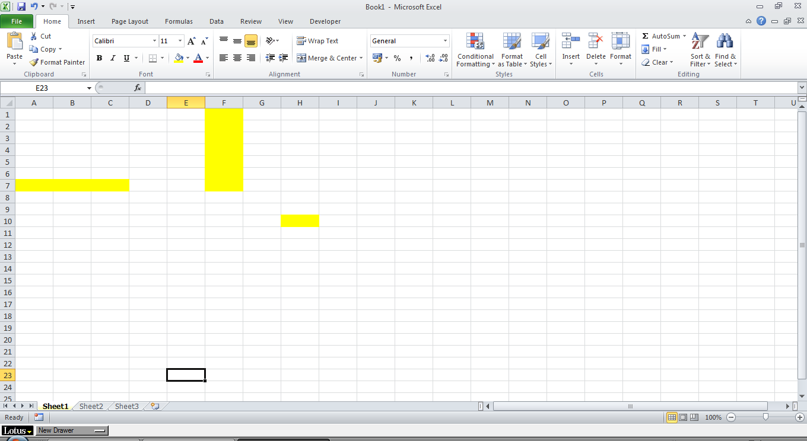
Workspace
First looks: Workspace
Rows, columns, cells, sheets, workbook

Slide 3
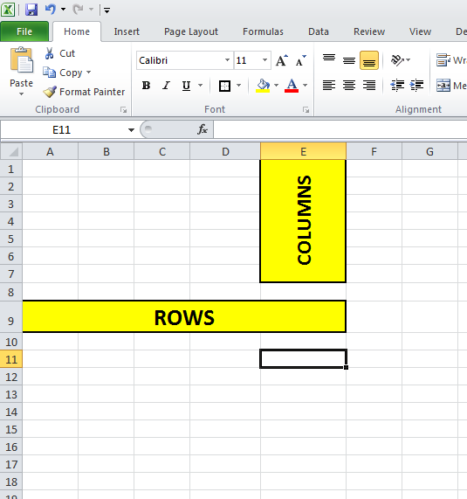
ROWS and COLUMNS
The workspace consists out of columns and rows, not a clean white page like word.
There are 1044576 rows and 16385 columns.
To make the Columns and rows wider you can right click on the grey Numbers or Letters and drag bigger

Slide 4

Cells
A Cell is the block or individual cell in the worksheet where you are currently working in

Slide 5

WORKSHEETS
Worksheet is the sheet that you are currently working on.

Slide 6
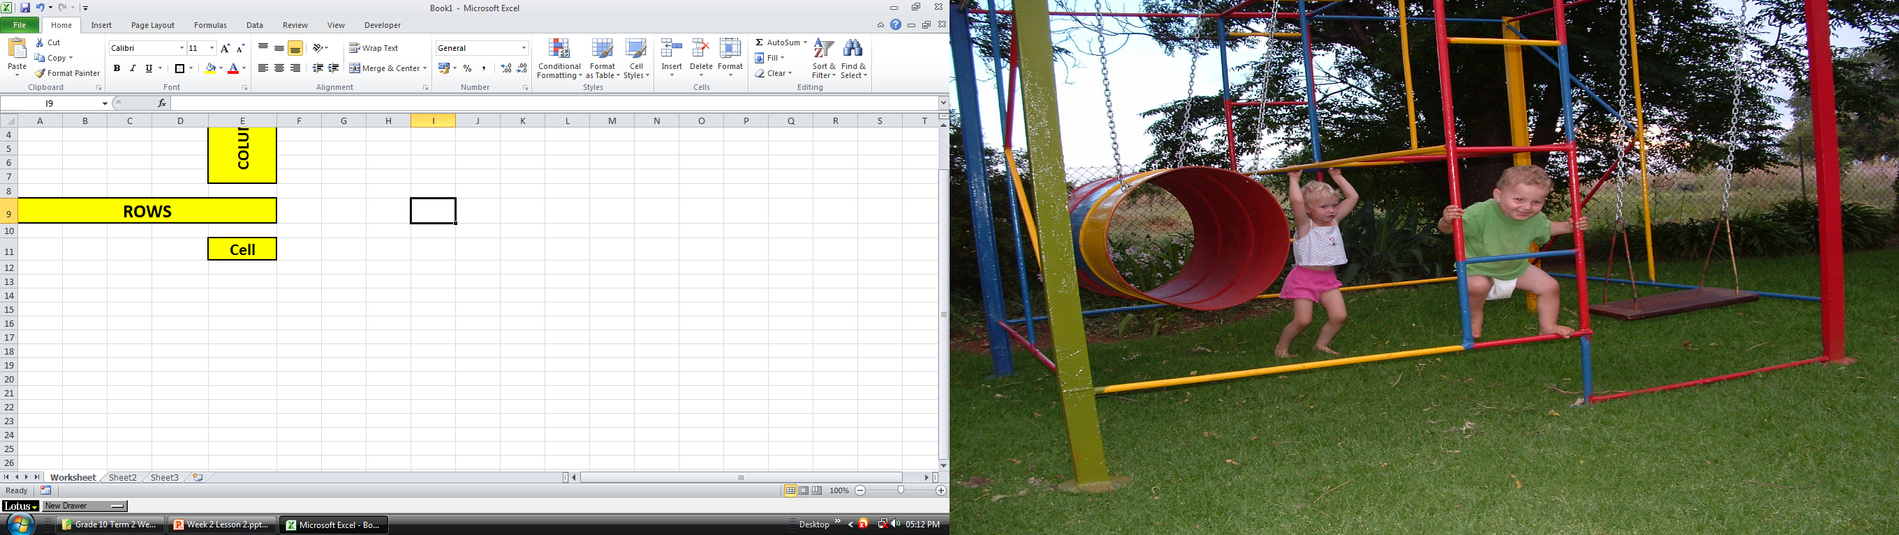
WORKBOOK
Workbook is the whole spreadsheet file, it contain all the pages in the file

Slide 7
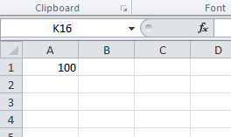
Cell Reference
Cell reference is when you combine the Letter and the number which contains the value (100) you will say A1.

Slide 8
Why use cell References
WHY is it importance to use cell references rather than constant values in cells and formulas:
Why using A1 and not 100
When using a function for example =(A1 + A1) the value (100) change to 200
When using a formula =(100 + 100) the answer will be 200 as well
BUT:
If you change the value (100) to 120, the formula used in nr 2 will not changed.

Slide 9
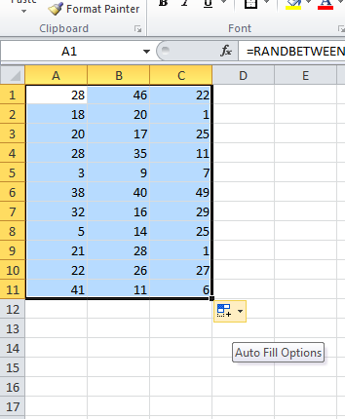
Cell Range
A cell range is a group of adjacent (together – no gaps in-between) that you can select by dragging the mouse across the numbers.

Slide 10
Activity
Yet another fun activity awaits

